Slide 1
Unsupervised Learning: Latent Variable Models
Ryan Dhindsa
Notes:
Will be a short class – quick explanation + remainder of time dedicated to HW

Slide 2
Unsupervised Learning
Unlabeled dataset
Attempts to find underlying patterns in the data
Examples:
Clustering
Anomaly detection
Others

Slide 3
Outline
Gaussian mixture models
Expectation-maximization
Factor analysis
Notes:
https://www.datascience.com/blog/k-means-alternatives
https://pythonmachinelearning.pro/clustering-with-gaussian-mixture-models/
https://jakevdp.github.io/PythonDataScienceHandbook/05.12-gaussian-mixtures.html

Slide 4
K-means
K-means works well when data is “spherical”
E.g. dataset on right shows 3 spherical clusters
K-means with k=3 reliably identifies the clusters
Notes:
The variance is the same in all directions

Slide 5
K-means
Data often not as neat as previous example
K-means creates suboptimal clusters
We need alternative clustering approaches
Notes:
While a scatter plot allows us to inspect our data for obvious clusters, K-means does not see like we do and will adhere to the algorithm.
This dataset shows clusters that show different variances in each direction.

Slide 6
Mixture models
2 types of clustering:
Hard clustering: clusters do not overlap (e.g. K-means)
Soft clustering: clusters may overlap
Mixture models provide probabilistic interpretations of cluster assignment
Need to learn mean and variances from dataset
Notes:
Each cluster is viewed as a probability distribution, so for each datapoint, you get a probability that a given datapoint is a member of cluster k

Slide 7
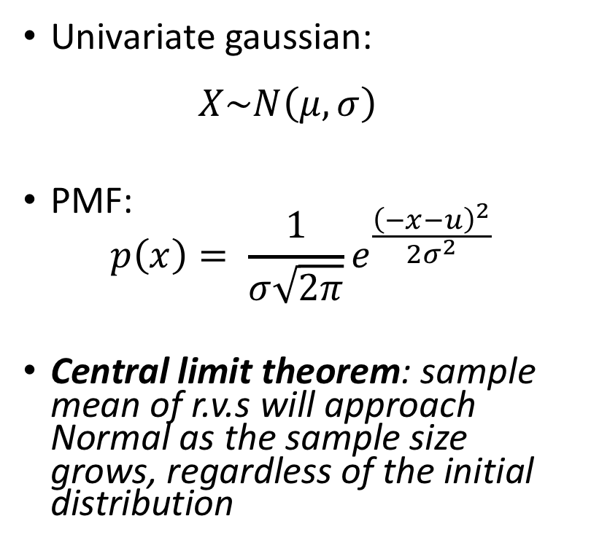
Gaussian (normal) distributions
Univariate gaussian: $X\sim N\left(μ, σ\right)$
PMF: $p\left(x\right)= \frac{1}{σ\sqrt{2π}}e^{\frac{{\left(−x−u\right)}^{2}}{2σ^{2}}}$
Central limit theorem: sample mean of r.v.s will approach Normal as the sample size grows, regardless of the initial distribution

Slide 8
1D example (labeled training set)
Let’s take a simple supervised example, in which we have 10 labeled data points
Notes:
Could simply use MLE to estimate the parameters of each Gaussian
(This supervised approach is called gaussian discriminant analysis)

Slide 9
Gaussian mixture models
What if we don’t know the labels?
We want to predict which distribution each point came from
The cluster is thus latent (hidden)
Notes:
We could take a guess
For each point, we would guess whether it is blue or red and calculate its posterior probability

Slide 10
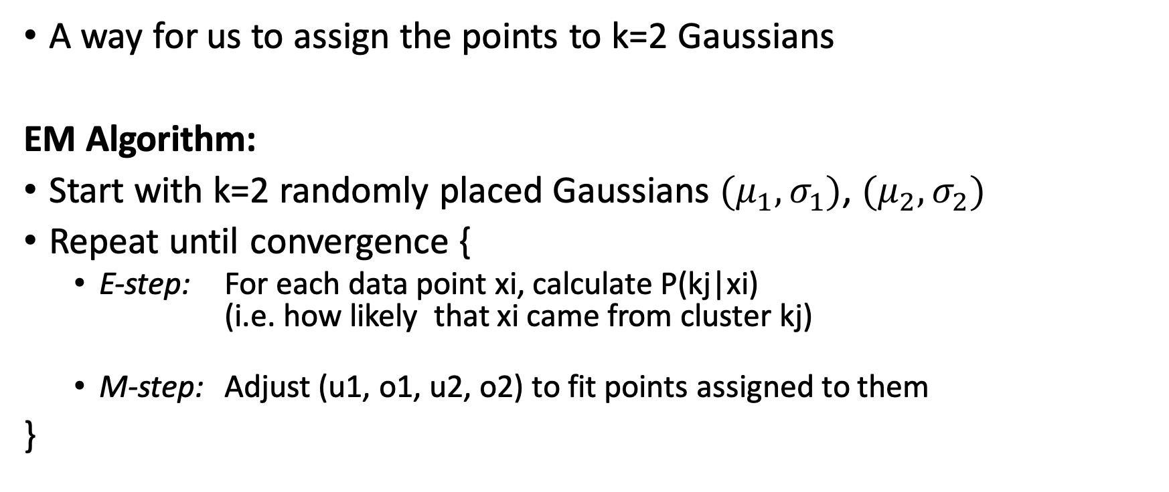
Expectation Maximization (EM)
A way for us to assign the points to k=2 Gaussians
EM Algorithm:
Start with k=2 randomly placed Gaussians ${(μ}_{1},σ_{1})$, ${(μ}_{2},σ_{2})$
Repeat until convergence {
E-step: For each data point xi, calculate P(kj|xi) (i.e. how likely that xi came from cluster kj)
M-step: Adjust (u1, o1, u2, o2) to fit points assigned to them
}
Notes:
We start with 2 Gaussians placed randomly in space, and for each paint
Use those randomly placed gaussians to “paint” the data points: is this color more likely to be blue or red?
Feed the colors back in to re-compute the mean and variance

Slide 11
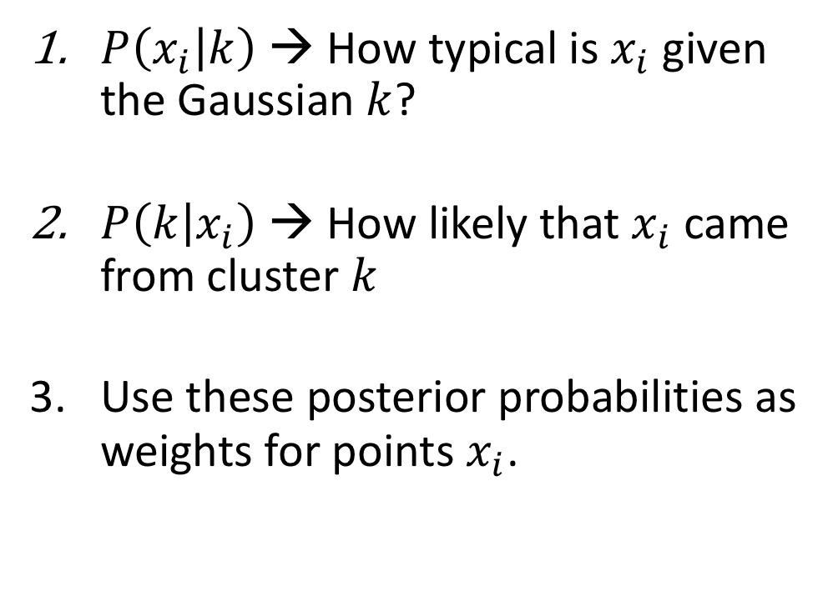
E-step
$P\left(x_{i} | k\right)$ → How typical is $x_{i}$ given the Gaussian $k$?
$P\left(k | x_{i}\right)$ → How likely that $x_{i}$ came from cluster $k$
Use these posterior probabilities as weights for points $x_{i}$.
Notes:
1)Suppose you’re aiming at a target, what is the probability your bullet lands here or there
2) Apply bayes’ rule and convert the previous probabilitiies into posteriors Assuming my probability landed here, was I shooting at the blue target or the red target?
Can think of it as painting the points
3) Of all the points painted red, how important is this particular point?

Slide 12
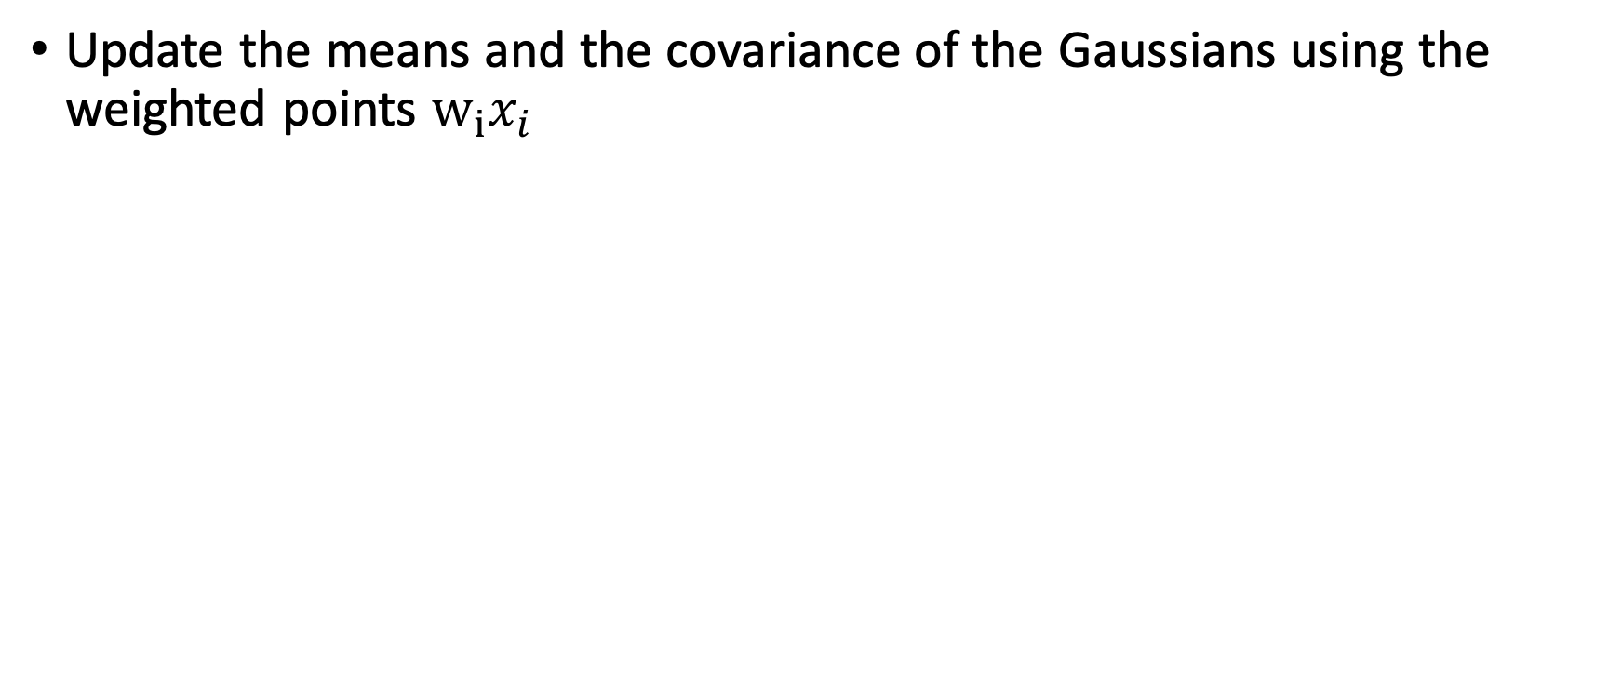
M-step
Update the means and the covariance of the Gaussians using the weighted points $w_{i}x_{i}$

Slide 13
Visualizing EM

Slide 14
Visualizing EM
Notes:
Randomly place 2 gaussians

Slide 15
Visualizing EM
Notes:
Paint colors based on how close they are to a gaussian’s mean

Slide 16
Visualizing EM
We “paint” the points based on $P\left(j | x_{i}\right)$ → How likely that $x_{i}$ came from cluster $j$
Notes:
In reality, we aren’t giving hard classifications! We are assigning probabilities
These probabilities allow us to assign weights to each point

Slide 17
Visualizing EM
Update the means and variances of our Gaussians based on previous weights
Notes:
In reality, we aren’t giving hard classifications! We are assigning probabilities

Slide 18
Visualizing EM
Repeat until convergence

Slide 19
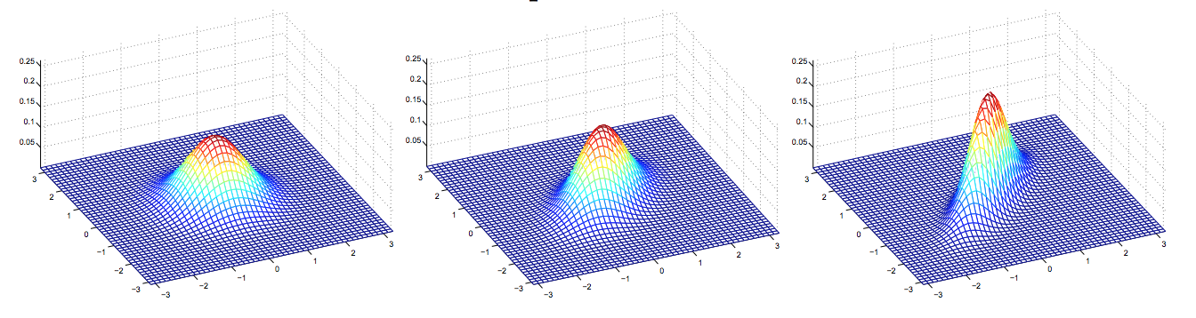
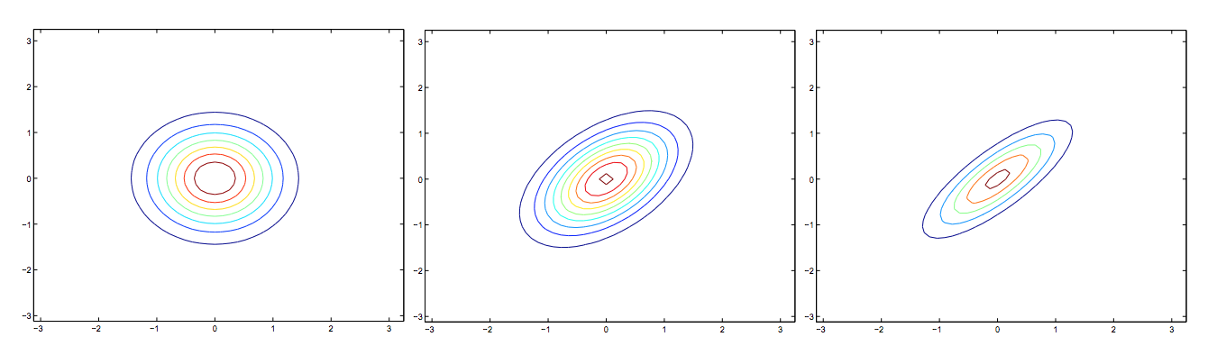
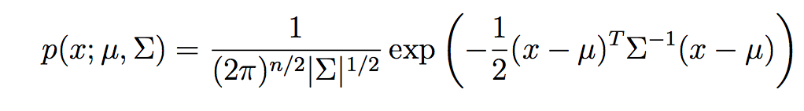
Multivariate Gaussians
Generalization of univariate Gaussian to higher dimensions
PMF:
Where ∑ is the covariance matrix
(picture credit: Andrew Ng)

Slide 20
How to pick K?
How do we choose the number of Gaussians?
Occam’s razor: pick “simplest” of all models that fit the data
Bayes information criterion (BIC)
Akaike information criterion (AIC)
Notes:
BIC and AIC try to estimate how well a model fits with a penalty for complexity
Maximize

Slide 21
GMM advantages & disadvantages
Advantages:
Probabilistic method
Soft clustering: data point can come from multiple clusters
Disadvantages: similar to k-means
Sensitive to starting point (should try multiple random initializations)
Converges to a local maximum
Notes:
Convergence:
- fixed number of iterations
OR
- Add some value epislon to the likelihood and when the difference becomes smaller than that value, stop

Slide 22
n >> m
GMMs work well when the number of training examples (m) is significantly larger than the dimension (n) of the data
Much more difficult to model data when n >> m
How do we deal with this situation?
Notes:
Cannot define covariance matrix when n >> m

Slide 23
Biological example
Microarray / RNA-seq data
20,000 genes (n)
Couple hundred samples (m)

Slide 24
Factor analysis
A method for reducing dimensionality
Assumption: variations in observed variables reflect variations in fewer latent variables

Slide 25
FA example: pre-medical course requirements
Scientific aptitude
Biology
Chemistry
Physics
Quantitative reasoning
Calculus
Statistics
Communication skills
Writing
Literature

Slide 26
FA example: pre-medical course requirements
Scientific aptitude
Biology
Chemistry
Physics
Quantitative reasoning
Calculus
Statistics
Communication skills
Writing
Literature

Slide 27
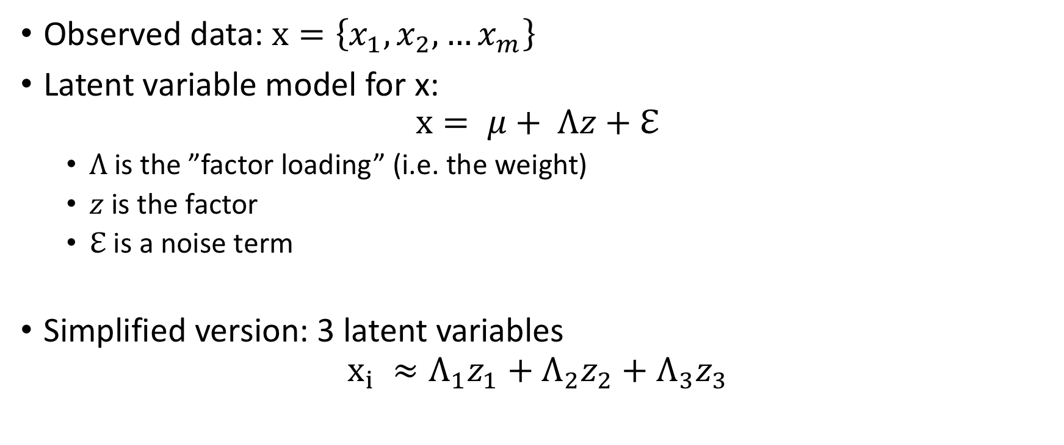
FA: the model
Observed data: $x=\left\{x_{1},x_{2},…x_{m}\right\}$
Latent variable model for x: $x= μ+ Λz+ℇ$
$Λ$is the ”factor loading” (i.e. the weight)
$z$ is the factor
$ℇ$ is a noise term
Simplified version: 3 latent variables
$$x_{i} ≈Λ_{1}z_{1}+Λ_{2}z_{2}+Λ_{3}z_{3}$$
* You do not need to know these equations; they are just here for reference
Notes:
Each data point is essentially a linear combination of the factors, with different weights

Slide 28
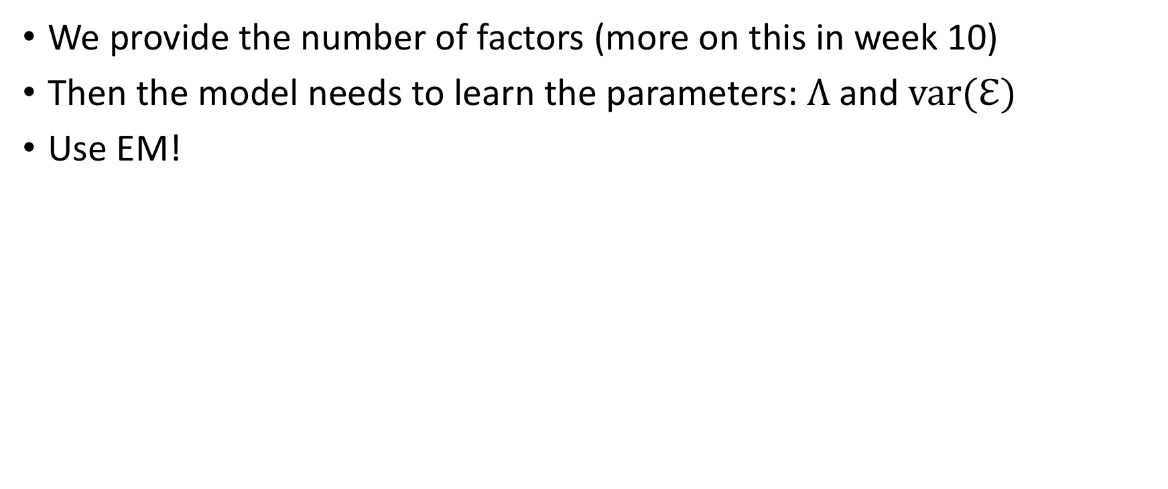
Performing FA
We provide the number of factors (more on this in week 10)
Then the model needs to learn the parameters: $Λ$and $var(ℇ)$
Use EM!

Slide 29
FA example output
300 students responded ranked their favorite subjects on a scale of 1-5
Subjects included: biology (BIO), geology (GEO), chemistry (CHEM), algebra (ALG), calculus (CALC), and statistics (STAT).
Ran FA with 2 factors
 | FACTOR 1 | FACTOR 2
BIO | .85 | .13
GEO | .78 | .13
CHEM | .86 | .06
ALG | .03 | .79
CALC | .10 | .97
STAT | .17 | .51

Slide 30
Can subjectively rename factors, e.g.:
Factor 1 = “Math”
Factor 2 = “Science”

Slide 31
Summary
Factor analysis is a way to reduce dimensionality of your data
Assumes that variance in the dataset originates from fewer latent variables
There are other approaches that you will learn in another lecture
You will also learn how to more objectively choose the number of factors

Slide 32
Note about the homework
Part 1: Gaussian mixture models
You will implement a GMM on the Old Faithful dataset
Part 2: Factor analysis
You will perform FA on survey responses to beer preferences
Plots will be manually graded, not through assertions

